Slide 1
X Education Case Study
Identifying ‘Hot Leads’

Slide 2
The problem
X Education
Context
Problem statement
X Education sells online courses to industry professionals. On any given day, many professionals who are interested in the courses land on their website and browse for courses.
X Education gets a lot of leads, but its lead conversion rate is very poor.
For example, if, say, they acquire 100 leads in a day, only about 30 of them are converted.
The company wishes to identify the most potential leads. The lead conversion rate should go up as the sales team will now be focusing more on communicating with the potential leads rather than making calls to everyone.

Slide 3
Challenges deep-dive
Challenge 1
Challenge 2
Challenge 3
Expand leads
Select the most promising leads, i.e. the leads that are most likely to convert into paying customers.
Assign lead score
Assign a lead score to each of the leads such that the customers with higher lead score have a higher conversion chance and the customers with lower lead score have a lower conversion chance.
High sensitivity
Target lead conversion rate to be around 80%

Slide 4
Solution
A Machine Learning based, supervised logistic regression model that predicts the probability of a lead to convert, with a high sensitivity of 83%
ML model to assign lead score

Slide 5
Implementation

Slide 6
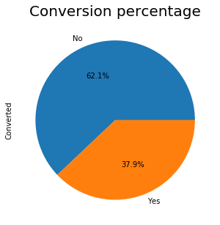
Conversion rate
As we analysed the dataset, we concluded that 37.9% of leads were successfully converted and rest 62.1% went cold. We aimed to identify the key factors that drive the lead conversion rate

Slide 7
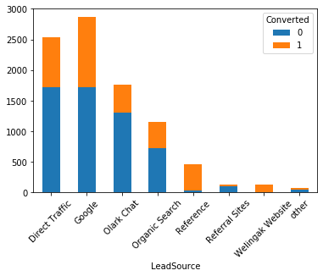
Lead sources
Upon further investigation, we found that maximum of leads came from Google and direct traffic. A couple other sources also include Olark chat and organic search. Google has a 40% conversion rate, while direct traffic has about 32%. Though reference and Welingak website fetched very low number of leads but have 92% and 98% conversion rate respectively.

Slide 8
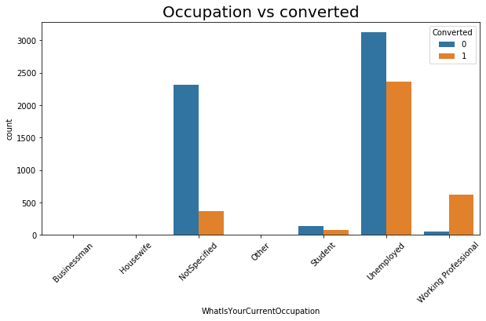
Lead occupation
Out of all occupations, only Working Professional have positive conversion rate, approx 91% while students have a conversion rate of about 36%. Unemployed people have highest number of leads but with a conversion rate of 43%.

Slide 9
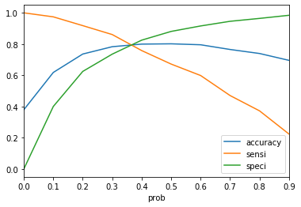
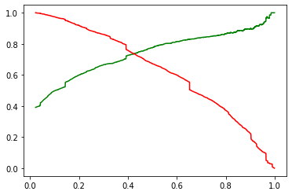
Identified factors
Precision and recall trade-off
From accuracy, specificity and sensitivity plot, we concluded that 0.35 is optimal cut-off probability.

Slide 10
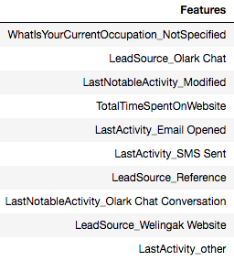
Identified factors
Using the supervised logistic regression of machine learning, we identified that following factors are key when deciding whether are not a lead would be converted. Out of these factors, Lead Source_WelingakWebsite, LeadSource_Reference and LastActivity_SMS Sent are top 3 factors. Notably, leads with not specified current occupation, last activity modified and last activity Olark chat have a negative affect on lead conversion rate.

Slide 11
The team
upGrad IIITB - PG Diploma Data Science
Student
Student
Amit Chawla
Harnoor Singh

Slide 12
Impact
Accurate lead scoring
Higher lead conversion

